Slide 1

AZZ Inc.
Strategy and Governance Update
February 6, 2024

Slide 2
Disclaimers
Cautionary Statements Regarding Forward Looking Statements — Certain statements herein about our expectations of future events or results constitute forward-looking statements for purposes of the safe harbor provisions of The Private Securities Litigation Reform Act of 1995. You can identify forward-looking statements by terminology such as "may," "could," "should," "expects," "plans," "will," "might," "would," "projects," "currently," "intends," "outlook," "forecasts," "targets," "anticipates," "believes," "estimates," "predicts," "potential," "continue," or the negative of these terms or other comparable terminology. Such forward-looking statements are based on currently available competitive, financial, and economic data and management’s views and assumptions regarding future events. Such forward-looking statements are inherently uncertain, and investors must recognize that actual results may differ from those expressed or implied in the forward-looking statements. Forward-looking statements speak only as of the date they are made and are subject to risks that could cause them to differ materially from actual results. Certain factors could affect the outcome of the matters described herein. This presentation may contain forward-looking statements that involve risks and uncertainties including, but not limited to, changes in customer demand for our products and services, including demand by the construction markets, the industrial markets, and the metal coatings markets. We could also experience additional increases in labor costs, components and raw materials including zinc and natural gas, which are used in our hot-dip galvanizing process; supply-chain vendor delays; customer requested delays of our products or services; delays in additional acquisition opportunities; an increase in our debt leverage and/or interest rates on our debt, of which a significant portion is tied to variable interest rates; availability of experienced management and employees to implement AZZ’s growth strategy; a downturn in market conditions in any industry relating to the products we inventory or sell or the services that we provide; economic volatility, including a prolonged economic downturn or macroeconomic conditions such as inflation or changes in the political stability in the United States and other foreign markets in which we operate; acts of war or terrorism inside the United States or abroad; and other changes in economic and financial conditions. AZZ has provided additional information regarding risks associated with the business, including in Part I, Item 1A. Risk Factors, in AZZ's Annual Report on Form 10-K for the fiscal year ended February 28, 2023, and other filings with the SEC, available for viewing on AZZ's website at www.azz.com and on the SEC's website at www.sec.gov. You are urged to consider these factors carefully when evaluating the forward-looking statements herein and are cautioned not to place undue reliance on such forward-looking statements, which are qualified in their entirety by this cautionary statement. These statements are based on information as of the date hereof and AZZ assumes no obligation to update any forward-looking statements, whether as a result of new information, future events, or otherwise.
Non-GAAP – Regulation G Disclosures — In addition to reporting financial results in accordance with Generally Accepted Accounting Principles in the United States ("GAAP"), AZZ has provided EBITDA and Adjusted EBITDA, which are non-GAAP measures. Management believes that the presentation of these measures provides investors with a greater transparency comparison of operating results across a broad spectrum of companies, which provides a more complete understanding of AZZ’s financial performance, competitive position and prospects for the future. Management also believes that investors regularly rely on non-GAAP financial measures, such as EBITDA and Adjusted EBITDA, to assess operating performance and that such measures may highlight trends in the Company’s business that may not otherwise be apparent when relying on financial measures calculated in accordance with GAAP.
2

Slide 3

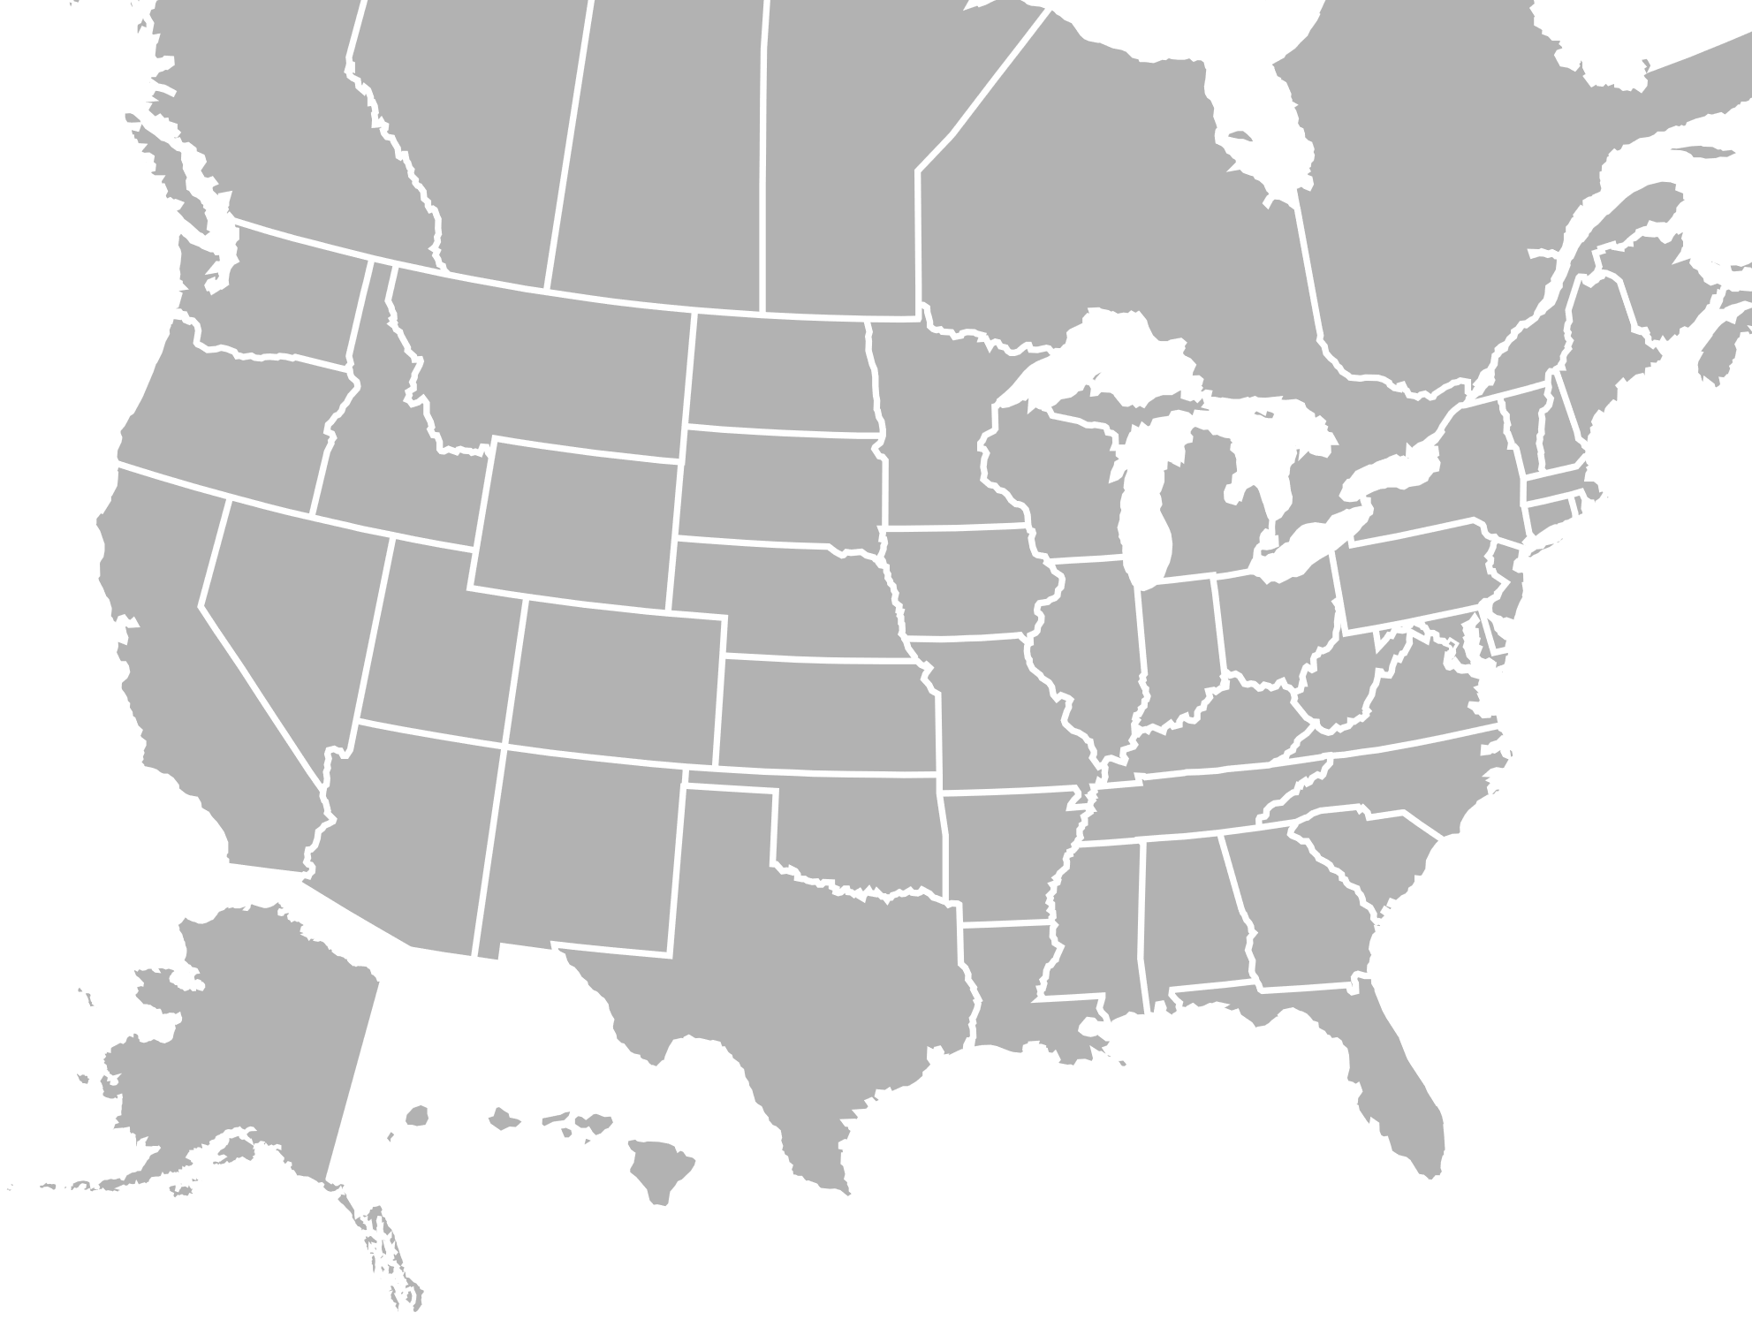
AZZ Snapshot (NYSE: AZZ)
FORT WORTH, TEXAS
Headquarters:
3,900
Employees:
Metal Coatings locations¹:
AZZ is North America’s leading independent post-fabrication hot-dip galvanizing & coil coating solutions company with #1 positions in both markets
48
Coil Coating Locations:
13
Sales
EBITDA³
Precoat Metals
Metal Coatings
$1.5B⁴
Market Cap
$1.5B²
Sales
$349M^{2,3}
Adj. EBITDA
23.2%
Adj. EBITDA Margin
41 galvanizing locations and 6 surface technologies locations; 1 tubular products location
Sales and Adjusted EBITDA based on results for last twelve months, ending November 30, 2023
Adjusted EBITDA excludes corporate costs
Market Cap as of January 30, 2024
1
Notes:
AZZ is North America’s largest independent hot-dip galvanizing and coil coating solutions company with #1 positions in both markets.
LTM sales of $1.5 billion reflects the strategic transformation that was recently completed.

Slide 4
AZZ’s Strategic Journey
$571
$810
$1,500
$2,000+
Sales, in millions
2024 +
Focused Metal Coatings Company
Investing in our future - New aluminum coil coating facility; on-budget and on–track for full production in FY 2026
Driving operational excellence with ESG focus
Expanding use of customer-centric technology (DGS and Coil Zone)
Capturing opportunities associated with long-term growth drivers in end markets
Strategic acquisitions to support growth
Reducing debt with leverage range of 2.5-3.0X
2019-2023
Strategic Transformation – Positioning for the future
Divested nuclear related businesses
Divested majority stake (60%) of non-core Infrastructure Solutions segment to a joint venture
Acquired Precoat Metals
Returned $79 million to shareholders through stock repurchases FY2021-FY2022
Reduced leverage from 4.2X to 3.1X
2013-2018
Optimized Legacy Footprint
Improved capabilities and profitability of Metal Coatings
Combined Electrical and Industrial assets into one operating segment (infrastructure Solutions)

Slide 5

We Value Our Dedicated Employees by fully training and equipping them, and providing a safe environment to grow personally, professionally and spiritually
We Value Our Customers by reliably providing high-quality products and solutions with outstanding customer service
We Value Our Shareholders by striving to consistently provide solid returns above our peer group and above all industrial indices
4

Slide 6
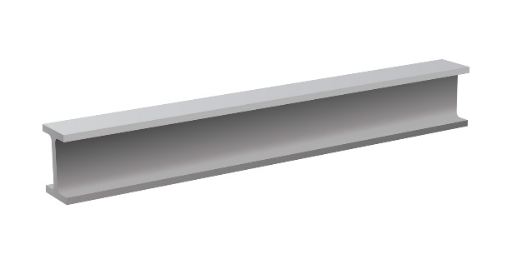



Our Leading Segments
Operating Segment
Production
Input
Production Route
Value-Added Capabilities
Market Size, Share and Position²
5-Year Historical EBITDA Performance
($ in millions)
Hot-Dip Galvanizing
Spin Galvanizing
Powder Coating
Plating
Anodizing
$2.3B
Metal Coatings
Batch
Processing
Sales $651 million¹
COVID
Fabricated Steel
~$28% share; #1 market position
Coil Coating
Slitting
Embossing
Shape Correction
Blanking
$3.7B
Precoat Metals
Continuous Processing
Acquired May 2022
Sales $856 million¹
Steel & Aluminum Coil
~23% share; #1 market position
Value-added tolling model limits risk and exposure to metal price fluctuation
Sales based on LTM ended November 30, 2023
Management estimates based on data from the American Galvanizing Association and National Coat Coaters Association

Slide 7
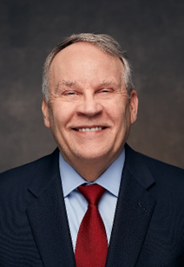
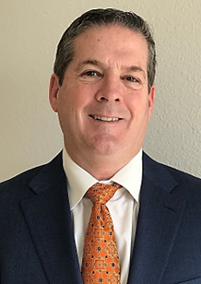
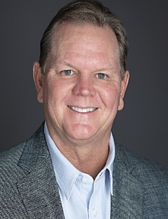
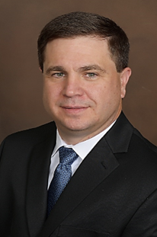
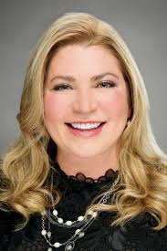
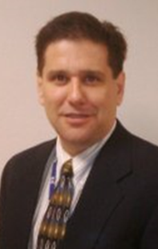
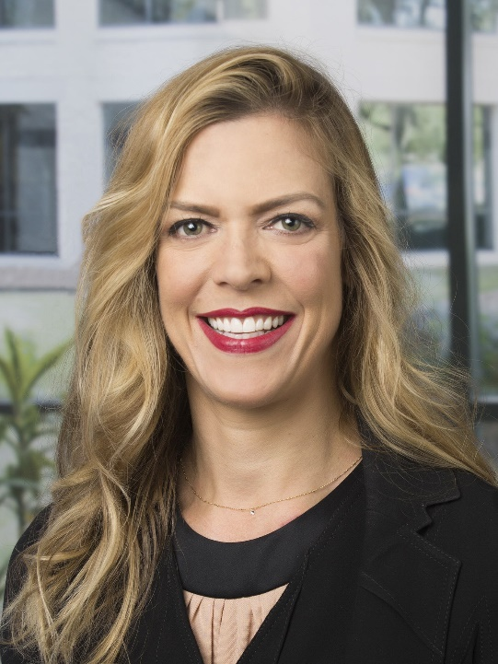
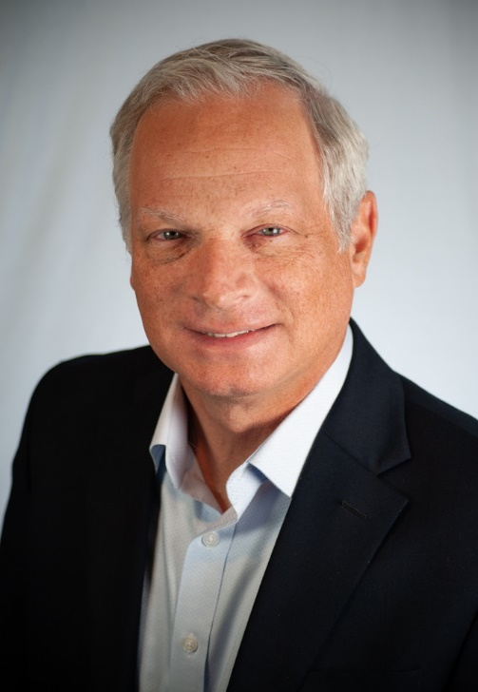
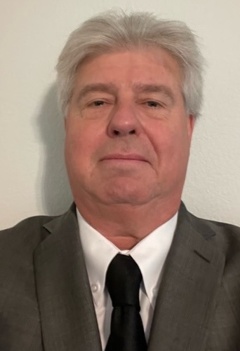






Mission-Driven, Experienced Management Team
Our Mission
Create superior value in a culture where people can grow and TRAITS matter.
We are diverse, collaborative, and service-minded, operating in a culture of TRAITS…Trust, Respect, Accountability, Integrity, Teamwork, and Sustainability
Leadership Highlights
Tom Ferguson
President and Chief
Executive Officer
Philip Schlom
Chief Financial Officer
Bryan Stovall
President & COO
Metal Coatings
Kurt Russell
President & COO Precoat Metals
+200 years of combined industry experience
Senior corporate leadership has tenure and a strong track record of success
Proven industry leaders at respective coatings businesses
Executed and integrated multiple acquisitions, including transformational M&A
Tara Mackey
Chief Legal Officer
Matt Emery
Chief Information and Human Resources Officer
Tiffany Moseley
Chief Accounting Officer
David Nark
SVP of Marketing,
Communications
and
Investor Relations
Chris Bacius
Vice President
Business Development
13
Notes:
The Management team includes two highly experienced COO’s (each over a segment). Corporate support is typical within a publicly traded company, insuring we have all legal, regulatory and SEC matters supported, as well as supporting the needs of the investment community while strategically looking at M&A to inorganically grow the segments. We operate in a culture where people can grow and TRAITS matter. TRAITS is an ackronym for Trust, Respect, Accountability, Integrity Teamwork and Sustainability

Slide 8
Strategic and Financial Initiatives to Enhance Shareholder Value
Metal Coatings
Precoat Metals
Capital Allocation
Focus on Driving Profitable Growth
Completed Strategic Acquisition (May 2022)
Increased Returns to Shareholders
#1 in post-fabrication hot-dip galvanizing¹
Strategic plant network of 41 hot-dip galvanizing locations and 6 surface technology locations with superior customer service
Highly attractive margins and returns
Pipeline of synergistic Metal Coatings acquisitions in North America
Resilient performance through economic cycles
#1 in pre-fabrication coil coating¹
Strategic plant network of 13 locations with deep customer relationships
Drive cost and margin improvement
Expanding capacity to meet industry demand with new greenfield facility in Washington, Missouri
Resilient performance through economic cycles
Deploying capital to high ROIC investments
Reducing Leverage – Target net leverage ratio of 3.0x in calendar 2024
Currently committed to sustaining dividends
Acquisitions currently deferred to focus on debt reduction
Infrastructure Solutions
Divested majority stake (60%) in low performing and low value creation business on 9/30/22
8
Management estimates based on data from the American Galvanizing Association and National Coat Coaters Association

Slide 9



Our Capital Allocation Priorities
Deploying Capital on High ROIC
Investments
Organic growth
Strategic customer partnerships
Productivity
Reduce
Leverage
At or below 3.0x leverage in calendar 2024
Return
Capital
Committed to sustaining dividends
Acquisitions
Deferred
19

Slide 10
Corporate Governance
Our Board believes that strong corporate governance is a essential to the continued success of AZZ
Board Independence
Board Practices
Board Accountability
Stock Ownership / Compensation
Independent Board (9 of 10 directors)
Independent Board Chair
All Board Committees comprised of independent directors
Regular executive sessions of independent directors
Annual Board and committee self-evaluations
Ongoing commitment to Board refreshment and diversity
Strategic planning and risk oversight by full Board and the Audit Committee
Corporate ESG practices and policies oversight by Nominating and Corporate Governance Committee
Orientation program for new directors and continuing education for all directors
Annual election of all directors
Majority voting for directors
Shareholders have the right to call a special meeting (15%)
Shareholder engagement program with feedback incorporated into Board deliberations
Mandatory retirement at 75 years of age
Robust stock ownership guidelines for the Board and each executive officer
No hedging or pledging of Company securities
An Incentive Compensation Recovery Policy applicable to former and current executive officers and key employees.
10

Slide 11
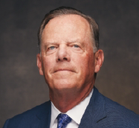
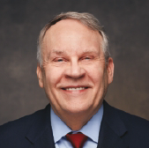
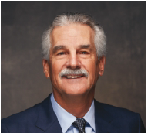
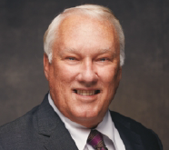
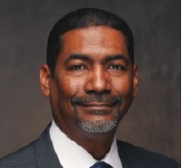
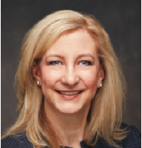
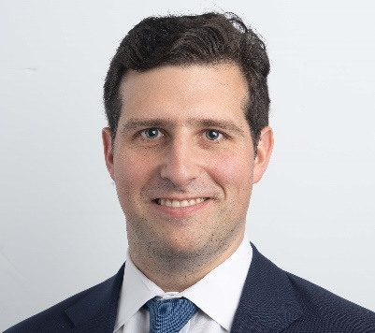
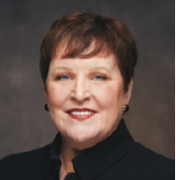
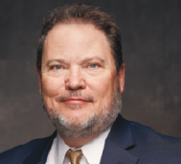
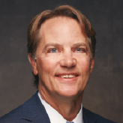
Our Board of Directors
Experienced leaders from a range of relevant backgrounds
Daniel Feehan
Chairman,
FirstCash and AZZ
Thomas Ferguson
President & CEO
AZZ
Daniel Berce
President & CEO,
General Motors Financial Company
Paul Eisman
Former President & CEO,
Alon USA Energy
Clive Grannum
President of Performance Materials
Materion Corporation
Brings significant executive leadership experience with financial reporting, business controls, accounting and strategic planning expertise
Former Chairman, President & CEO at Cash America
Brings considerable global business and leadership experience with industry, strategic planning, growth and acquisition expertise
Former Interim CEO at FlexSteel Pipeline Technologies
Brings executive leadership experience with corporate governance, executive compensation, accounting and financial expertise
Former CEO at AmeriCredit Corp
Brings extensive experience in leading refining production companies and retail business operations
Former Executive Vice President of Refining and Marketing Operations at Frontier Oil Corporation
Brings executive leadership experience with strategic M&A, global manufacturing, business development, process improvement, financial and transformational growth expertise
Former Corporate Officer and President of Global Chlorinated Organics at Olin and President of Global Chlorinated Organics at Dow Chemical
Carol Jackson
Former President, CEO & Chairman,
HarbisonWalker International
David Kaden
Managing Director
Blackstone Tactical Opportunities
Venita McCellon-Allen
Former President & COO,
Southwestern Electric
Power Company
Ed McGough
SVP of Global Manufacturing & Technical Operations,
Alcon
Steven Purvis
Former Principal of
Luther King Capital Management
Brings executive leadership with expertise in global business operations, industrial manufacturing, M&A and legal matters in addition to public Board experience in the steel and coatings industries
Former Corporate Officer, VP and GM at Carpenter Technology Corporation
Brings expertise in global business operations, M&A
Current Managing Director at Blackstone Tactical Opportunities Group
Former White House Director for International Economics on the National Security Council and National Economic Council
Brings executive leadership experience with operations, corporate governance, external affairs, regulatory, M&A, talent development and executive compensation expertise
Former Executive Vice President at AEP Utilities
Brings executive leadership experience with global manufacturing, distribution, supply chain, digital technology and acquisition integration expertise
Former VP of Manufacturing and Pharmaceutical Operations, Alcon
Brings experience in analyzing corporate strategy and investment decisions across multiple industries with financial analytics expertise
Former Trustee and Portfolio Manager of Luther King Capital Management
Independent Chairman
11

Slide 12

Board Composition
We have thoughtfully constructed our Board to advance our strategy
Summary of Director Experience, Qualifications, Attributes and Skills | Feehan | Ferguson | Berce | Eisman | Grannum | Jackson | Kaden | McCellon- Allen | McGough | Purvis
CEO / Senior Executive Leadership Experience | ● | ● | ● | ● | ● | ● | ● | ● | ● | ●
Financial Expertise | ● |  | ● | ● | ● | ● | ● |  |  | ●
Manufacturing and Distribution Expertise |  | ● |  | ● | ● | ● |  |  | ● | ●
Technological Expertise |  | ● |  |  | ●
International Experience | ● | ● | ● |  | ● | ● | ● |  | ●
Strategic Planning and Oversight | ● | ● | ● |  | ● | ● | ● | ● | ● | ●
Corporate Governance | ● | ● | ● | ● | ● | ● | ● | ● | ● | ●
Mergers and Acquisitions | ● | ● | ● | ● | ● | ● | ● | ● | ● | ●
Digital Technology |  | ● |  |  |  |  |  |  | ●
12

Slide 13
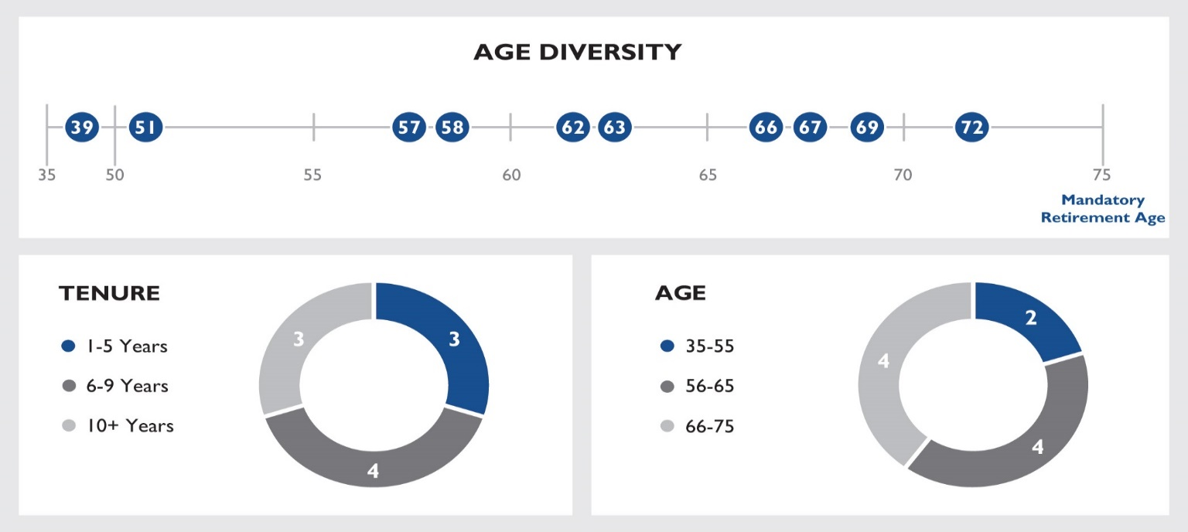
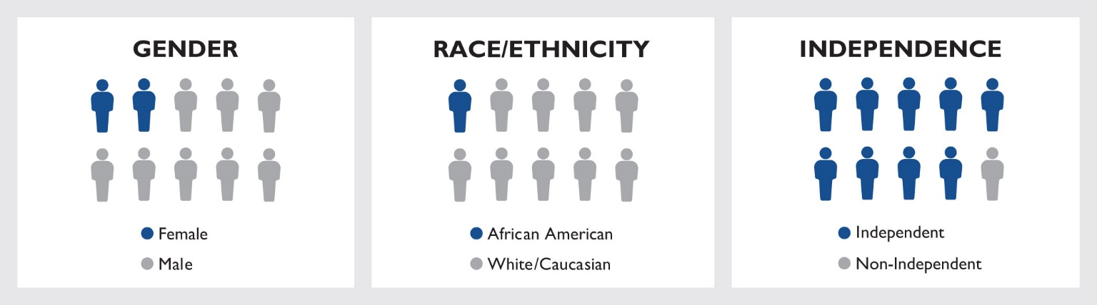
Board Commitment to Diversity
We believe that diversity helps to support a high functioning Board
Note: Data above reflects the status of the Board as of February 28, 2023, our last fiscal year-end
13

Slide 14
Our Board’s Evaluation and Refreshment Process
Commitment to regular refreshment to evolve AZZ’s Board in line with its strategy
Process Overview
Key Desired Skills
Robust Board evaluation and succession planning process
Regularly evaluate mix of Board attributes, skills and experiences in the context of our strategy and evolving industry and governance trends
Focus on director candidates who possess a multitude of skills, professional experiences and backgrounds aligned with our strategy
Prioritization of diverse backgrounds and perspectives
CEO, CFO or Other Executive Level Experience
Financial and Accounting Expertise
Corporate Governance Experience
General Knowledge of the Metal Coatings Solutions Industry and/or Manufacturing and Distribution Expertise
Strategic Planning and Oversight Expertise
Digital Technology
Mergers and Acquisitions Experience
Key Selection Criteria
Our Process in Action
Relevant industry knowledge and diversity of background and experience
Executive level experience
Strategic planning, capital markets and oversight
Diversity of race, ethnicity, gender, age, background and experience
Willingness to represent the best interests of shareholders and objectively challenge management’s performance
Extensive experience in mergers, acquisitions and integration
Financial and accounting expertise
Corporate Governance expertise
3 New Independent Directors Added Since 2021
Clive Grannum
President, Performance Materials
Materion Corporation
Carol Jackson
Former President,
CEO & Chair,
HarbisonWalker International
David Kaden
Managing Director
Blackstone
Tactical Opportunities Group
14

Slide 15
Board Committees and Risk Oversight
Our approach to committee composition and responsibilities
Our Board has overall responsibility for the effective oversight of enterprise risk, whether financial, operational or strategic
The Board has delegated responsibility for oversight of certain risks to its committees who regularly meet and report to the full Board
Established robust internal processes and controls designed to allow management to effectively identify and mitigate risks and to timely communicate results to the Board
Audit Committee
Compensation Committee
Nominating and Corporate
Governance Committee
Daniel Berce (C), Paul Eisman, Clive Grannum, David Kaden, Venita McCellon-Allen, Steven Purvis
Ed McGough (C), Daniel Berce, Daniel Feehan, Clive Grannum,
Carol Jackson, Venita McCellon-Allen
Carol Jackson (C), Daniel Feehan, Paul Eisman, Ed McGough, Steven Purvis
Oversees robust internal processes and controls for identifying and managing risk, including comprehensive internal and external audit processes
Oversees the integrity of the financial statements and the independent auditor's qualifications and independence
Oversees risks relating to the Company’s compensation philosophy and programs and any impact it may have on management risk taking
Monitors risks relating to management and organizational structure, as well as succession planning of executive officers and other key leadership personnel
Oversees Board and Committee composition, Board compensation and the Company’s corporate governance principles and practices
Provides oversight of AZZ's environmental, social and governance policies and sustainability practices
Risk Oversight by Executive Management
Management focusing on the day-to-day responsibility and management of risks, in the following select areas:
Governance
Sustainability
Operations
Public Disclosure
Implementing Strategic Growth Initiatives
Cybersecurity
Compliance Programs
Financial Reporting
Litigation
Successful Integration of Acquisitions
15

Slide 16
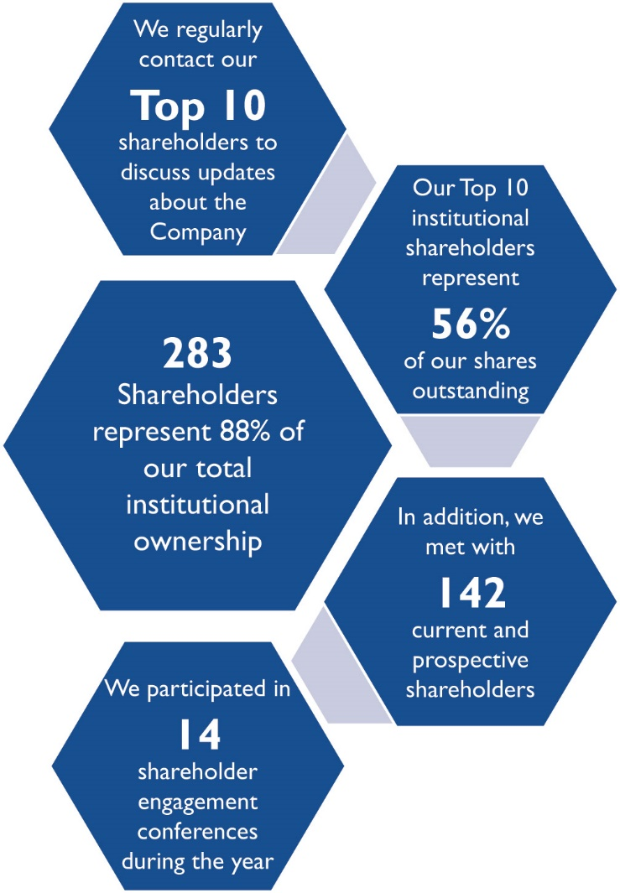
Shareholder Engagement FY 2023
Maintaining an active dialogue with our shareholders is important to our commitment to deliver sustainable, long-term value
Process Overview
Our Chair and members of our executive management team regularly engage with shareholders on various topics and carefully considers the feedback received to take action when appropriate
We have increased our shareholder engagement communications, enhanced the Company’s strategic content, and built stronger relationships with the investor community through our senior vice president of marketing, communications and investor relations
The feedback we receive from our shareholders provides our Board and executive management team with insights into the material topics of importance to our shareholders
16

Slide 17
Shareholder Engagement
Key Engagement Topics Discussed with Shareholders
Financial Performance and Deleveraging
Board Oversight of Corporate Strategy and Risk Management
Board Composition, Continuous Focus on Board Refreshment and Diversity
Sustainability, Corporate Responsibility and AZZ’s ESG Commitments
Human Capital Management
Shareholder Engagement and Activism
17

Slide 18
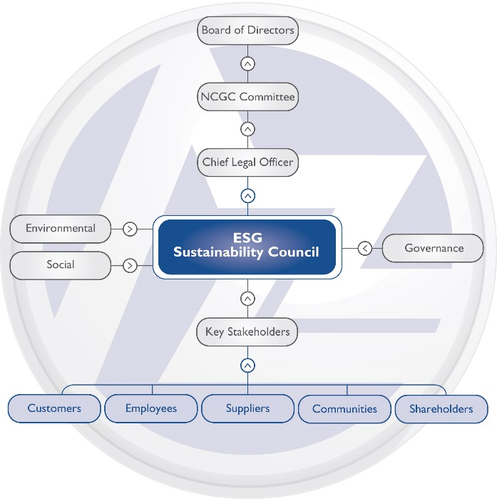
Prioritizing Corporate Responsibility and Sustainability
Committed to growing our business in a sustainable and socially responsible manner
Approach to Sustainability
ESG Oversight Structure
Our sustainability framework is integrated into our overall business strategy through our focus areas of environmental stewardship, social responsibility and corporate governance
We strive to improve the efficiency of our operations, including increasing energy and resource efficiency, lowering greenhouse gas emissions, reducing water consumption, conserving natural resources and offering products and solutions with superior sustainability attributes that meet or exceed our customer’s needs
Sustainability Framework Focus Areas
Environmental Stewardship
Social Responsibility
Corporate Governance
We strive to provide high quality products and solutions to our customers while maintaining compliance with environmental requirements and using raw materials in an environmentally conscious and sustainable manner
We believe that investing in our people, our communities and our business sustainably will drive long-term value for AZZ and its shareholders
The Nominating and Corporate Governance Committee provides Board-level oversight to the Sustainability Council, AZZ’s ESG policies and practices, and progress on AZZ’s ESG initiatives and targets.
18

Slide 19
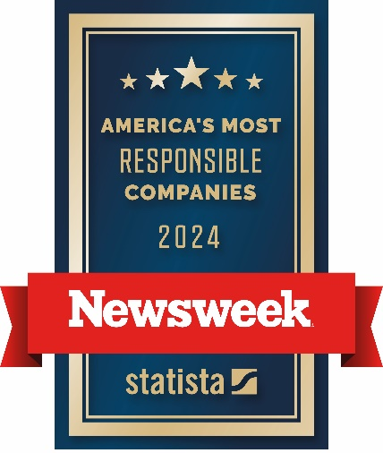
Recent ESG Highlights
Published our third corporate sustainability report, covering fiscal year 2021, 2022 and 2023 and incorporated our new Precoat Metals segment into the report.
Engaged a third-party consultant to assist AZZ in performing a materiality assessment on newly acquired Precoat Metals and further develop AZZ’s ESG strategy and near-term ESG priorities.
Named in Newsweek’s List of America’s Most Responsible Companies in 2023 and 2024.
Established several public and internal ESG targets for each of our identified material ESG topics.
Began tracking green sales for FY2024 to further disclose AZZ’s role in the transition to a low carbon economy.
Completed energy audits at three of our Metal Coatings facilities in partnership with the University of North Texas and DOE and one energy audit of our Precoat Metals facility in Houston, Texas with Texas A&M University and the DOE.
Please refer to our website to view our most current Environmental, Social Responsibility and Governance Report
19

Slide 20
Environmental Stewardship
Committed to managing our business is an environmentally responsible manner and prioritizing the health and safety of our employees
Environmental, Health and Safety Goals
Meet or exceed all applicable environment, health and safety (“EHS”) regulations and company standards and continuously monitor and document our progress
Continuously improve on our environmental performance by monitoring our progress against stated environment, health and safety and sustainability targets to promote energy efficiency and to protect and sustain the environment
Train and equip our employees to identify and mitigate any hazards associated with their job
Reduce our environmental footprint by minimizing emissions, energy and water usage and recycling materials where possible
Closely monitor our chemical consumption and waste generation in order to efficiently utilize raw materials and minimize and recycle non-product outputs
Focus on sourcing environmental solutions that will decrease AZZ’s footprint
Contribute to the development and administration of technically and economically sound environmental standards and compliance procedures through seeking input from professional trade groups, regulatory agencies, citizens' organizations, subject matter experts, and our stakeholders
Communicate our EHS performance and sustainability progress against our internal targets to our stakeholders
Our Board oversees the management team’s environmental, healthy and safety (“EHS”) practices and programs as we execute on our goals and initiatives
20

Slide 21

Commitment to Human Capital Management
Our employees are our greatest asset – our success is dependent on the expertise and engagement of all our people
Our Culture
Our Commitment to Health and Safety
AZZ understands the importance of employees who feel valued and united through shared beliefs and guiding principles
Our values shape our corporate culture, attract highly skilled employees and help them live and perform at their best
At AZZ, our employees’ well-being is a priority. We offer Market Place Chaplains, Employee Assistance Programs, health insurance and 401 (K) benefits to all employees
We take pride in offering incentives that recognize employee efforts and programs to help improve our employee’s quality of life
We established the AZZ Cares Foundation to provide financial assistance to our employees and their families when a personal emergency, disaster or personal hardship occurs
AZZ Alertline is available 24/7 in three languages to address concerns and increase accountability
We are a diverse, collaborative and service-minded organization that operates in a culture of:
Trust, Respect, Accountability, Integrity, Teamwork and Sustainability
  We strive to incorporate continuous improvement in the health and safety of our facilities by establishing and monitoring our progress against our EHS and sustainability targets
  We train and equip our employees to identify and mitigate hazards associated with their job
  Our management teams oversee the implementation of training programs for operational safety and hazard reduction and regularly communicate EHS results to our employees
Our Commitment to Diversity and Inclusion
More than 51% of our employees are diverse, as reported to the Equal Employment Opportunity Commission on an annual basis
We embrace the diversity of our employees, customers, vendors, suppliers, stakeholders and consumers, including their unique backgrounds, experiences, creative solutions, skills and talents
We seek to continuously improve our hiring, development, advancement and retention of a diverse talent pool and increase our overall diversity representation
21

Slide 22
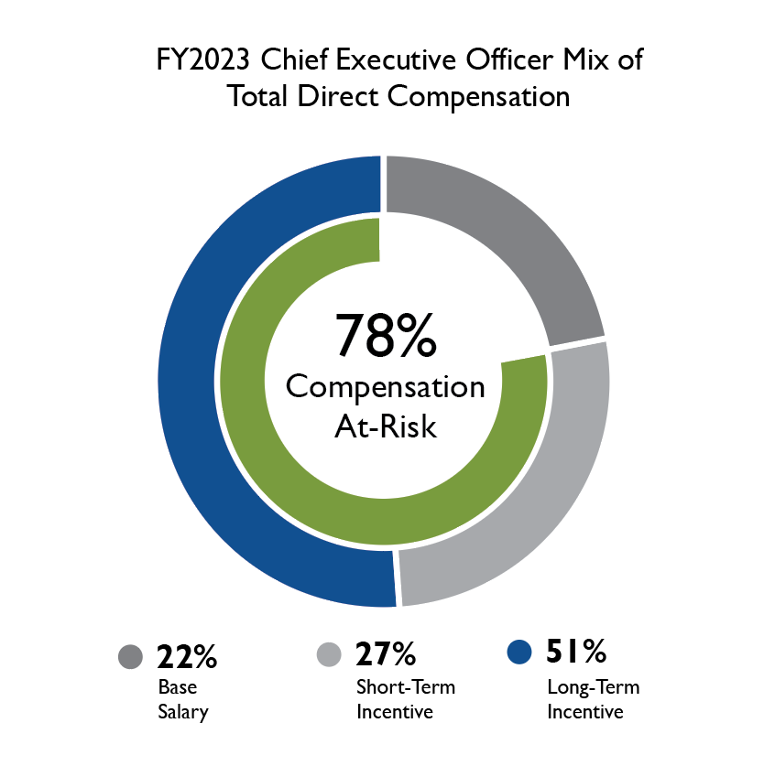
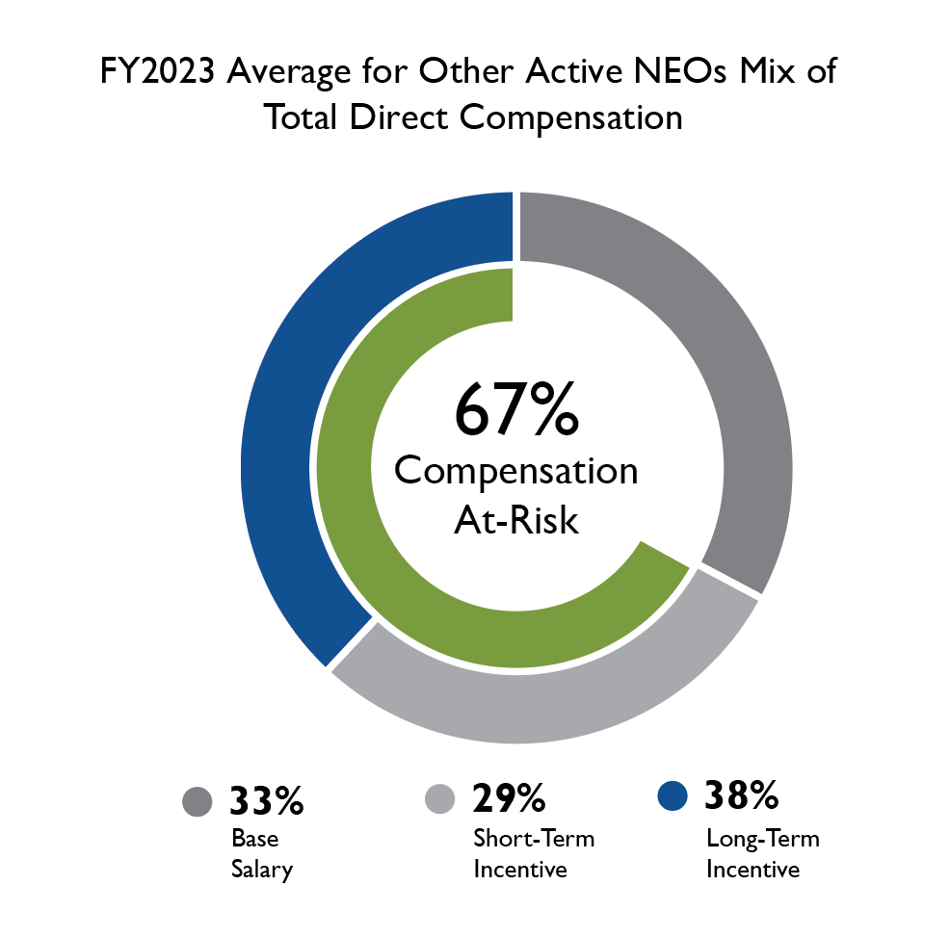
Executive Compensation Philosophy and Design
Compensation Aligned with Value Creation
FY2023 Incentives Aligned with Strategic Plan
FY2023 Target Pay Mix
Profitability
75% of our CEO’s annual incentive cash award for FY2023 was based on performance against target Adjusted EPS⁽¹⁾
Qualitative Contribution
25% of our CEO’s annual incentive cash award was based on the collective performance of the entire leadership team to achieve AZZ’s FY2023 financial targets and maintain its leading market position and value creation for its shareholders.
Shareholder Value Creation
PSUs (50%) based on relative TSR at the end of a three-year performance cycle relative to our industry peer group
RSU’s (50%) have a prorated 3-year vesting period
Adjusted EPS is a non-GAAP number and the FY2023 adjustments are specifically set forth and described in Appendix B, page B-1 of the FY2023 Proxy Statement that was filed with the SEC on May 30, 2023 and is also available on AZZ’s website at www.azz.com/financial-information/2023 Proxy Statement.
22

Slide 23

Our Path to Delivering Long-Term Shareholder Value
Integrating Human Capital, Diversity and Environmental Initiatives into our Operations and Corporate Culture
Ensuring Shareholder Engagement is embedded into developing and executing on AZZ’s Strategic Goals
Focusing on Driving Profitable Growth in both Metal Coatings and Precoat Metals Segments
Completed Acquisition of Precoat Metals and Divestiture of Majority Stake in Infrastructure Solutions, and focusing on seamless integration of Precoat’s operating systems and internal controls
Targeting Increased Capital Returns to Shareholders
Experienced Board is Advising on Strategy, Overseeing Risk and Supporting Long-Term Value Creation
23

Slide 24
Appendix and Additional Information

Slide 25
Reconciliation of Segment Financials
(a) – Reported in conformity with US GAAP
(1) – Reflects impact of Galvabar divestiture (closed in July 2020)
(2) – Reflects impact of NLI and SMS divestitures (closed in February 2020 and October 2020,
respectively)
(a) – Reported in conformity with US GAAP
(1) – Reflects impact of Galvabar divestiture (closed in July 2020)
(2) – Reflects impact of NLI and SMS divestitures (closed in February 2020 and October 2020,
respectively) and a $3.8M one-time adjustment in the electrical platform
(3) – Reflects ($5.4M) impact of NLI and SMS divestitures and add back of $5.3M non-recurring expenses in electrical platform and $8.6M in industrial platform
25

Slide 26
Reconciliation of Segment Financials (Continued)
(a) – Reported in conformity with US GAAP
(1) – Reflects impact of Galvabar divestiture (closed in July 2020)
(2) – Reflects impact of NLI and SMS divestitures (closed in February 2020 and October 2020,
respectively)
(a) – Reported in conformity with US GAAP
(1) – Reflects impact of Galvabar divestiture (closed in July 2020)
(2) – Reflects impact of NLI and SMS divestitures (closed in February 2020 and October 2020,
respectively)
(3) – Reflects add back related to loss on sale of NLI
26

Slide 27
Reconciliation of Segment Financials (Continued)
(a) – Reported in conformity with US GAAP
(1) – Reflects impact of Galvabar divestiture (closed in July 2020) and related restructuring and
impairment charges
(2) – Reflects impact of NLI and SMS divestitures (closed in February 2020 and October 2020,
respectively) and related restructuring and impairment charges
(a) – Reported in conformity with US GAAP
(1) – Reflects a reversal of a portion of the previously recognized impairment charges
27

Slide 28
Reconciliation of Segment Financials (Continued)
Reported in conformity with US GAAP
Corporate adjustments related to acquisition addback
27

Slide 29
Thank You

